Slide 1
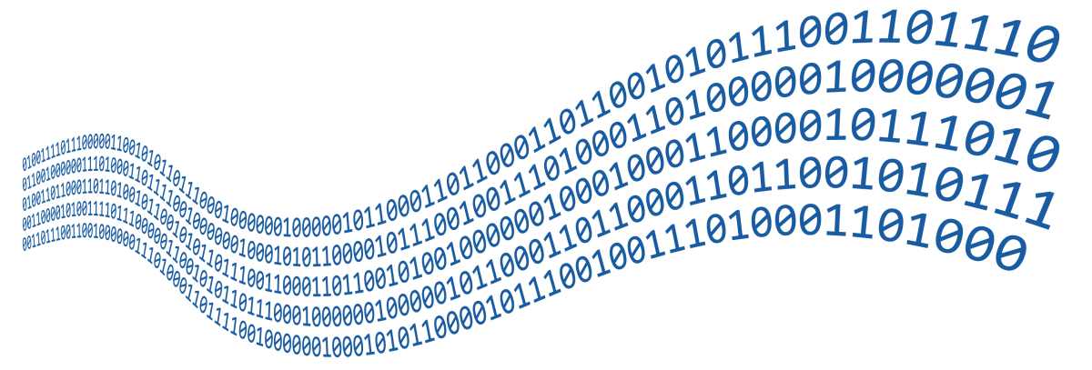
Streams and Files
File Types, Using Streams and Manipulating Files
SoftUni Team
Technical Trainers
Software University
http://softuni.bg

Slide 2

Table of Contents
What are Streams?
Stream Basics
2. Readers and Writers
3. Stream Types
File
Memory
Network Streams

Slide 3
Have a Question?
sli.do
#fund-csharp

Slide 4

What Is a Stream?
Basic Concepts

Slide 5


What is a Stream?
Streams are used to transfer data
We open a stream to:
Read data
Write data
1100 1001 1001
Stream
Notes:
Icons by Chanut is Industries / Pixel perfect at http://www.flaticon.com/

Slide 6
Stream Basics
Streams are means for transferring (reading and writing) data
Streams are ordered sequences of bytes
Provide sequential access to its elements
Different types of streams are available to access different data sources:
File access, network access, memory streams and others
Streams are opened before using them and closed after that

Slide 7
Stream – Example
Length = 9
Position is the current position in the stream
Buffer keeps n bytes of the stream from the current position
F i l e s a n d
46 | 69 | 6c | 65 | 73 | 20 | 61 | 6e | 64
Position
Buffer
46 | 69
6c | 65
73 | 20
61 | 6e
64

Slide 8
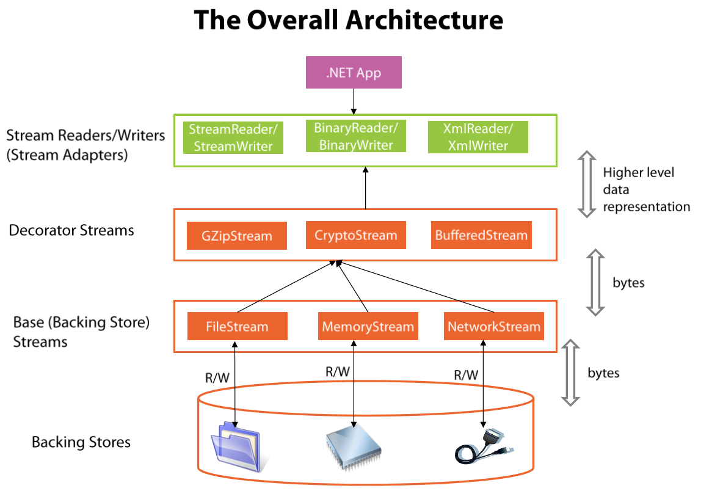
Stream Types in .NET

Slide 9

Readers and Writers
Text and Binary readers/writers

Slide 10
Readers and Writers
Readers and writers are classes which facilitate the work with streams
Two types of streams
Text readers/writers – StreamReader / StreamWriter
Provide methods ReadLine(), WriteLine() (similar to working with the system class Console)
Binary readers/writers – BinaryReader / BinaryWriter
Provide methods for working with primitive types
ReadInt32(), ReadBoolean(), WriteChar(), etc.

Slide 11
Using statement
Streams, readers, files, etc. use certain resources
Using statement close them and release their resources
var reader = new StreamReader(fileName);
using (reader)
{
// Use the reader here
}

Slide 12
Problem: Read File
Read all content from your Program.cs file
Print it to the console with line numbers
Line 1: using System;
Line 2: using System.IO;
Line 3:
Line 4: class Program
Line 5: {
using System;
using System.IO;
class Program
{

Slide 13
Solution: Read File
StreamReader reader = new StreamReader("somefile.txt");
using (reader) {
int lineNumber = 0;
string line = reader.ReadLine();
while (line != null) {
lineNumber++;
Console.WriteLine("Line {0}: {1}", lineNumber, line);
line = reader.ReadLine();
}
}

Slide 14
Problem: Write to File
Read your Program.cs file
Reverse each line of the file
Save it in reversed.txt
using System.IO;
class Program
{
;OI.metsyS gnisu
margorP ssalc
{

Slide 15
Writing Reversed Text to File – Example (1)
using (var reader = new StreamReader("../../Program.cs"))
{
using (var writer = new StreamWriter("../../reversed.txt"))
{
string line = reader.ReadLine();
// continiues on the next slide
}
}

Slide 16
Writing Reversed Text to File – Example (2)
while (line != null)
{
for (int i = line.Length - 1; i >= 0; i--)
{
writer.Write(line[i]);
}
writer.WriteLine();
line = reader.ReadLine();
}

Slide 17

Base Streams
File, Memory, Network

Slide 18
The System.IO.Stream Class
The base class for all streams is System.IO.Stream
There are defined methods for the main operations with streams in it
Some streams do not support read, write or positioning operations
Properties CanRead, CanWrite and CanSeek are provided
Streams which support positioning have the properties Position and Length

Slide 19
Methods of System.IO.Stream Class
int Read(byte[] buffer, int offset, int count)
Read as many as count bytes from input stream, starting from the given offset position
Returns the number of read bytes or 0 if end of stream is reached
Can freeze for undefined time while reading at least 1 byte
Can read less than the claimed number of bytes
F i l e s a n d
46 | 69 | 6c | 65 | 73 | 20 | 61 | 6e | 64

Slide 20
Methods of System.IO.Stream Class (2)
Write(byte[] buffer, int offset, int count)
Writes a sequence of count bytes to an output stream, starting from the given offset position
Can freeze for undefined time, until it sends all bytes to their destination
Flush()
Sends the internal buffers data to its destination (data storage, I/O device, etc.)

Slide 21
Methods of System.IO.Stream Class (3)
Close()
Calls Flush()
Closes the connection to the device (mechanism)
Releases the used resources
Seek(offset, SeekOrigin)
Moves the position (if supported) with given offset towards the beginning, the end or the current position

Slide 22

File Stream

Slide 23
The FileStream Class
Inherits the Stream class and supports all its methods and properties
Supports reading, writing, positioning operations, etc.
The constructor contains parameters for:
File name
File open mode
File access mode
Concurrent users access mode

Slide 24
The FileStream Class (2)
FileMode – opening file mode
Open, Append, Create, CreateNew, OpenOrCreate, Truncate
FileAccess – operations mode for the file
Read, Write, ReadWrite
FileShare – access rules for other users while file is opened
None, Read, Write, ReadWrite
var fs = new FileStream(string fileName, FileMode,
[FileAccess], [FileShare]);
Optional parameters

Slide 25
Writing Text to File – Example
string text = "Кирилица";
var fileStream = new FileStream("../../log.txt",
FileMode.Create);
try {
byte[] bytes = Encoding.UTF8.GetBytes(text);
fileStream.Write(bytes, 0, bytes.Length);
}
finally
{ fileStream.Close(); }
try-finally guarantees the stream will always close
Encoding.UTF8.GetBytes() returns the underlying bytes of the character

Slide 26
Copying File – Example (1)
var source = new FileStream(SheepImagePath, FileMode.Open)
using (source)
{
var destination =
new FileStream(DestinationPath, FileMode.Create);
using (destination)
{
//...
}
}
using automatically closes the stream

Slide 27
Copying File – Example (2)
while (true)
{
byte[] buffer = new byte[4096];
int readBytes = source.Read(buffer, 0, buffer.Length);
if (readBytes == 0)
{
break;
}
destination.Write(buffer, 0, readBytes);
}

Slide 28
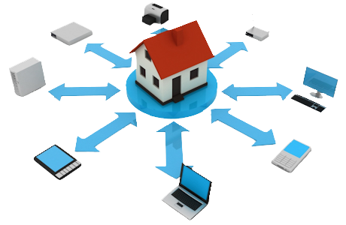
Other Streams
Memory Stream, Network Stream

Slide 29
Reading In-Memory String – Example
string text = "In-memory text.";
byte[] bytes = Encoding.UTF8.GetBytes(text);
using (var memoryStream = new MemoryStream(bytes)) {
while (true) {
int readByte = memoryStream.ReadByte();
if (readByte == -1)
break;
Console.WriteLine((char) readByte);
}
}

Slide 30
Simple TCP Server – Example
var tcpListener = new TcpListener(IPAddress.Any, PortNumber);
tcpListener.Start();
Console.WriteLine("Listening on port {0}...", PortNumber);
while (true) {
using (var stream = tcpListener.AcceptTcpClient().GetStream())
{
//continues on the next slide
}
}
Gets the stream

Slide 31
Simple TCP Server – Example
byte[] request = new byte[4096];
stream.Read(request, 0, 4096);
Console.WriteLine(Encoding.UTF8.GetString(request));
string html = string.Format("{0}{1}{2}{3} - {4}{2}{1}{0}",
"<html>", "<body>", "<h1>", "Welcome to my awesome site!", DateTime.Now);
byte[] htmlBytes = Encoding.UTF8.GetBytes(html);
stream.Write(htmlBytes, 0, htmlBytes.Length);
Reads request
Writes response

Slide 32
Buffered Streams (1)
Buffer the data and effectively increase performance
Call for read of even 1 byte makes read of more kilobytes in advance
The stream keeps them in an internal buffer
Next read returns data from the internal buffer
Very fast operation

Slide 33
Buffered Streams (2)
Written data is stored in internal buffer
Very fast operation
When buffer overloads:
Flush() is called
The data is sent to its destination
In .NET we use the System.IO.BufferedStream class

Slide 34

Live Exercises

Slide 35

Summary
…
…
…
Streams are ordered sequences of bytes
Serve as I/O mechanisms
Can be read or written to (or both)
Can have any nature – file, network, memory, device, etc.
Always close streams by using try-finally or using(…)

Slide 36
https://softuni.bg/courses/csharp-advanced

Slide 37













SoftUni Diamond Partners

Slide 38





SoftUni Organizational Partners

Slide 39




Trainings @ Software University (SoftUni)
Software University – High-Quality Education and Employment Opportunities
softuni.bg
Software University Foundation
http://softuni.foundation/
Software University @ Facebook
facebook.com/SoftwareUniversity
Software University Forums
forum.softuni.bg

Slide 40

License
This course (slides, examples, demos, videos, homework, etc.) is licensed under the "Creative Commons Attribution-NonCommercial-ShareAlike 4.0 International" license

